Slide 1

Topic: Shape, Spread, Skew and Outliers EQ: How do you compare the shape, spread, skew and outliers?
Year 11 Essentials

Slide 2
First 5
Topic: Shape, Spread, Skew and Outliers EQ: How do you compare the shape, spread, skew and outliers?
Divide 32m of timber into 5 equal lengths. How long would each piece be?
My car uses 1L of fuel every 12km. Petrol costs $1.25/L. How much does it cost me to drive for 400km.
I am 1.62m tall. My handprint measures 18cm. Write the ratio of handprint: height.
Seven and five hundredths' metres = _______ cm
12 478 + _______ = 13 603
6.4 m or 640cm
Approximately $42 ($41.67)
18:162 or 1:9
705cm
1 125

Slide 3
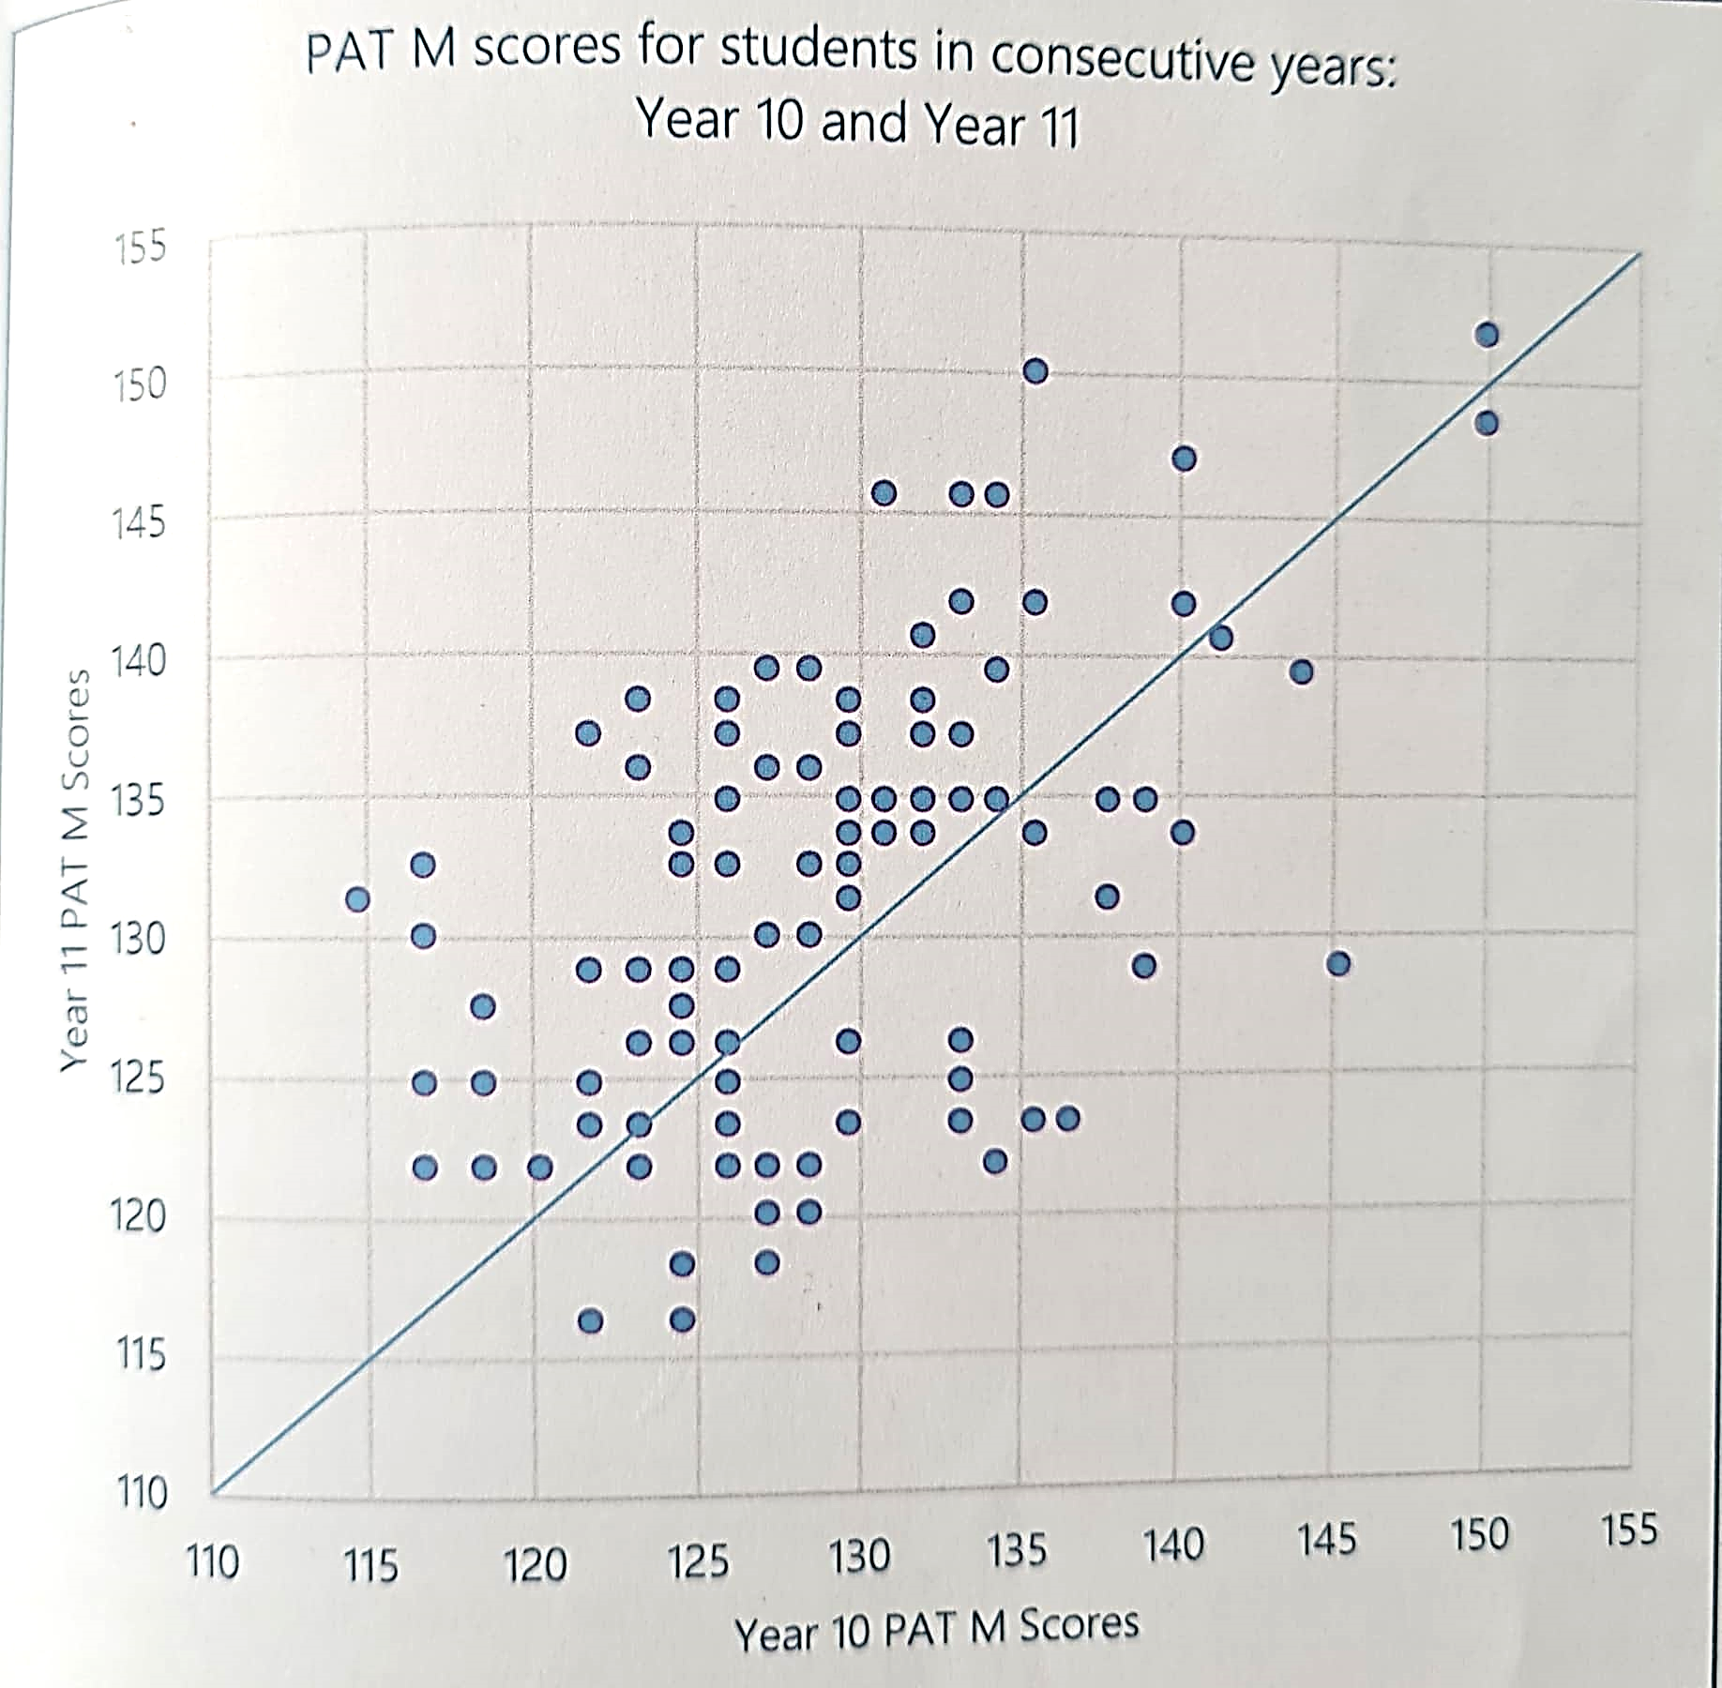
Topic: Shape, Spread, Skew and Outliers EQ: How do you compare the shape, spread, skew and outliers?
What is a scatterplot?
When looking at numerical data, it is helpful to organise it then look at the shape it forms.
Scatter plots represent bivariate data (two variables)
where each value of one of the variables is paired with a value of the other variable.

Slide 4
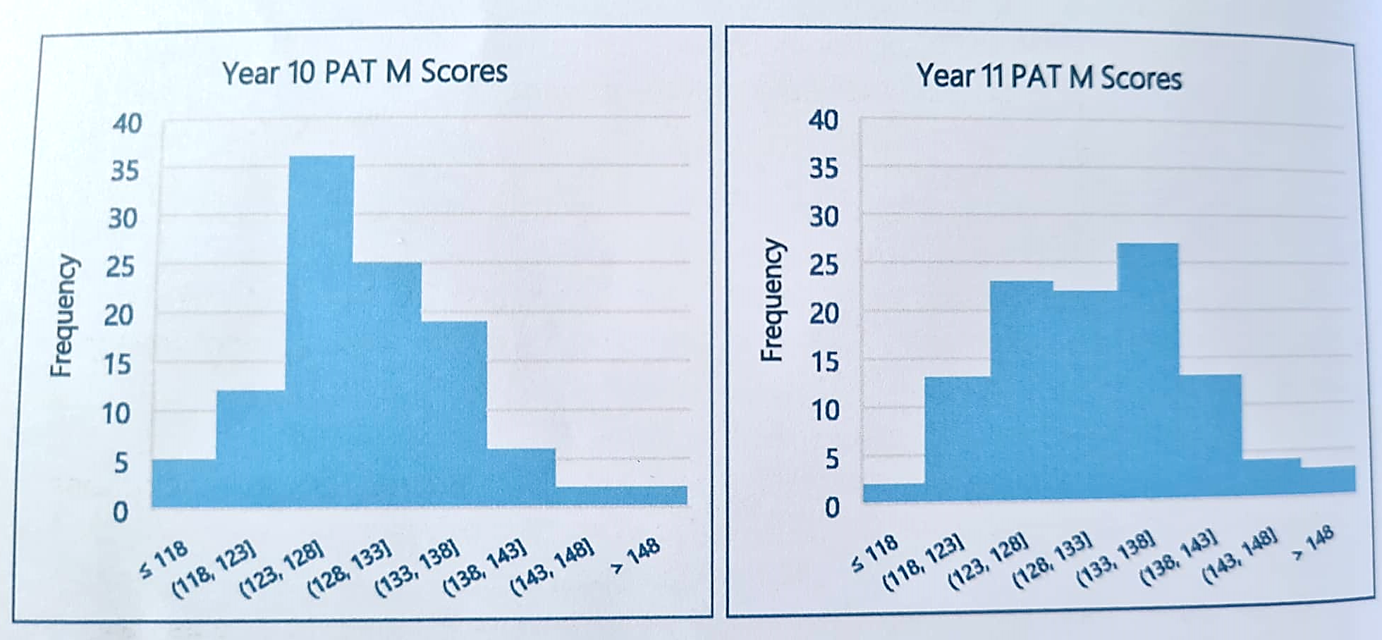
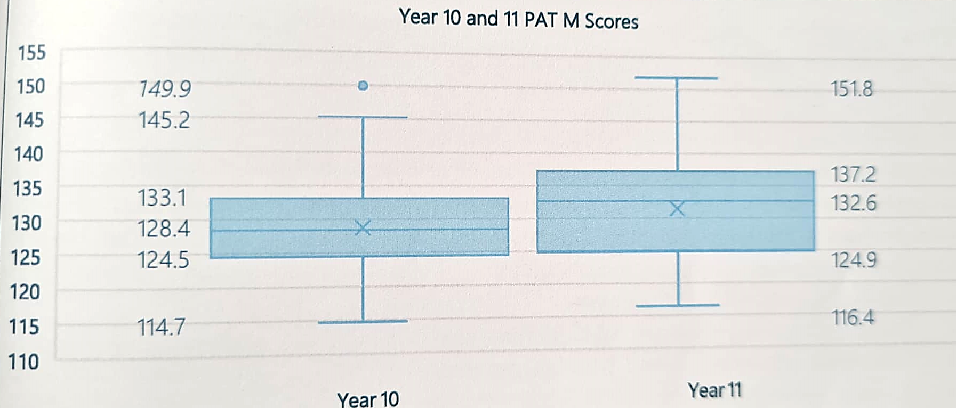
Topic: Shape, Spread, Skew and Outliers EQ: How do you compare the shape, spread, skew and outliers?
What is a histogram?
What is a box and whisker plot?
Shows a range of scores and is used for variables whose values are numerical and measured on an interval scale.
A box and whisker plot displays variation in a set of data and can provide additional details. These are good for test scores.

Slide 5
TASK: Explore
Page 99-101
Topic: Shape, Spread, Skew and Outliers EQ: How do you compare the shape, spread, skew and outliers?
Complete the questions relating to scatter plots, histograms and box and whisker plots.
Notes:
Print of student task reports to show the use of box and whisker plots so they can analyse the data and how useful it can be to represent data.

